Slide 1
IMMUNOMODULATOR DRUGS
DR. SUJEEVANI KURUKULASURIYA
CONSULTANT RHEUMATOLOGIST

Slide 2
Introduction
Improves clinical features of inflammation
Modifies disease process
Improves laboratory markers of inflammation

Slide 3
Types of immunomodulator drugs 1/4
Inhibition of lymphocyte activation
Corticosteroids
Methotrexate
Azathioprin
Mycophenilate mofitil
Leflunomide

Slide 4
Types of immunomodulator drugs 2/4
Interference with cytokine expression or signaling
Corticosteroids
Infliximab
Etanercept

Slide 5
Types of immunomodulator drugs 3/4
Conventional
Sulphasalazine
Hydoxychloroquine
Gold
Penicillamine

Slide 6
Types of immunomodulator drugs 4/4
Alkylating agents
cyclophosphamide

Slide 7
Place of DMARDS
Diagnosis made of RA
Introduce DMARD
Corticosteroid bridge therapy
Ct. NSAIDS
Physiotherapy/OT

Slide 8
Established disease
Maintain on DMARD as long as joint inflammation persists
Sequential/combination therapy
Withdraw/s.o.s. NSAIDS
Use corticosteroids in flares

Slide 9
The choice and combination of immunomodulatory drugs
Depends on
Severity of disease
Adverse effects
Organ involvement
Age
Co-morbidities
Pregnancy /Breast feeding
Evidence base

Slide 10
DMARDs have been classified as
]
synthetic (sDMARD)
  conventional synthetic and targeted synthetic DMARDs
  csDMARDs are the traditional drugs
  (such as methotrexate, sulfasalazine,
  leflunomide, hydroxychloroquine,)
  tsDMARDs are drugs that were developed to target a
  particular molecular structure
biological: original and biosimilar DMARDs

Slide 11
Methotrexate

Slide 12
Methotrexate
Earlier used for treatment of cancer.
Now used in much lower doses for treatment of skin,joint and bowel disease.
Joint disease-Rheumatoid arthritis,Psoriatic arthritis, Juvenile idiopathic arthritis.
Skin disease-severe psoriasis
Cohns disease.

Slide 13
Mechanism of action
Folic acid antagonist
Competitive inhibition of enzyme dihydrofolate reductase.Protein synthesis effected.
Anti inflammatory effects
Cytokine modulating effects

Slide 14
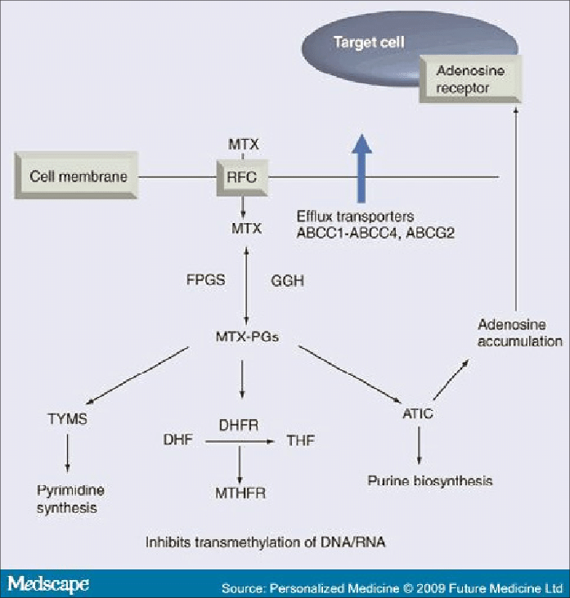

Slide 15
Adverse effects
Best tolerated DMARD
Nausea
Mouth ulcers -Painful
Pancytopenia(idiosyncratic)
Cirrhosis (esp.psoriasis pts)
Acute interstitial pneumonitis-fatal
Teratogenic

Slide 16
sulphasalazine

Slide 17
Comprises sulphapiridine and 5-amionosalicylic acid linked by an azo bond.
This azo bond is split by colonic bacteria
Sulphapiridine has an anti folate action.

Slide 18
Indications
RA
Spondyloarthropathy with peripheral joint involvement.
Psoriatic arthritis
Inflammatory bowel disease

Slide 19
Adverse effects
Gastrointestinal disturbances
Blood disorders
Hepatotoxicity
Skin reactions

Slide 20
Hydoxychloroquine

Slide 21
Introduction
Anti inflammatory
Immunomodulatory
Less effective than other DMARDS
Also less toxic.

Slide 22
Mode of action
Not known
??? Accumulates in lymphocytes, macrophages, polymorphs,fibroblasts and inhibits phagocyte function.

Slide 23
Indications
Connective tissue disorders-arthralgias
Combination therapy in RA

Slide 24
Adverse effects
Retinal damage-may be irreversible→eye testing
Skin discolouration
Bleaching of hair
Alopecia
GI disturbances

Slide 25
Leflunomide
Selectively inhibits pyrimidine synthesis.
Prevents T cell proliferation.
Onset of action 4-6 w
Retained in the body for 2 yrs (need elimination therapy with cholestyramine /activated charcoal)

Slide 26
Adverse effects
Gastrointestinal problems.
Mouth ulcers
Hypertension
Headache
Leucopoenia
Erythema multiforme,Steven Johnson syndrome,Toxic epidermal necrolysis.

Slide 27
Azathioprine

Slide 28
Introduction
Severe disease
Failed to respond to other treatment
Esp.for patients with extra articular features such as vasculitis.

Slide 29
Mode of action
Metabolized to 6-mercaptopurine
Inhibitor of purine synthesis
Cellular response is impaired.
TPMT(thiopurine methyltransferase) metabolizes 6 mercaptopurine.
Low levels of TPMT leads to toxicity.

Slide 30
Indications
RA
Psoriatic arthritis
Auto immune diseases-steroid sparing effect
Immuno suppressant-post organ transplant

Slide 31
Adverse effects
Rash
Marrow suppression
Liver toxicity
Hypersensitivity
Nausea
Diarrhoea

Slide 32
Penicillamine
? Mode of action
2nd line DMARD
Use limited due to adverse effects

Slide 33
Adverse effects
Proteinurea→nephrotic syndrome
Rash
Thrombocytopenia,aplastic anaemia

Slide 34
Mycophenolate mofetil

Slide 35
Mycophenolate mofetil
Metabolized to mycophenolic acid
This inhibits inosine monophosphate dehydrogenase

Slide 36
Mycophenolate mofetil
Acute rejection following organ transplant
Primary systemic vasculitides
Lupus nephritis

Slide 37
Cyclophosphamide

Slide 38
Cyclophosphamide
Cytotoxic
Damages DNA dividing cells
Triggers apoptosis
IV pulses /oral

Slide 39
Cyclophosphamide /indications
Renal lupus
ANCA positive vasculitides
Rheumatoid vasculitis

Slide 40
Cyclophosphamide / side efects
Haemorrhagic cystitis
BM toxicity
Infertility
Teratogenicity

Slide 41
Biological agents

Slide 42
Introduction
Agents derived from natural substances and chemically altered.
Poor response to DMARDS
Expensive
Infliximab
Etanercept
Adalimumab
Rituximab
Golimumab

Slide 43
Adverse reactions
Infections
Hypertension
Skin reactions
Fatigue
Worsening congestive cardiac failure

